Slide 1
Facilitated Meeting:
Optimizing Nutrition
Tuesday, July 23rd 2019
10:00 AM
Library Program Room
Beatty Hall

Slide 2
Facilitators & Roles
Amanda Siciliano - Leader
Paige Taylor - Activity Facilitator
Joseph Jennings - Questionnaire
Ian Itzla - Peacemaker, Time Keeper
Jordan Hammons - Taskmaster

Slide 3
Ground Rules
& Agenda

Slide 4
Ice Breaker
Orange = What’s the coolest food you have ever eaten?
Pink = Share an unusual food pairing that you love.
Yellow = If you could eat only one food for the rest of
your life, what would it be and why?
Red = How many times a week do order take out/ go out?

Slide 5
Facilitated Session Goals
Optimize nutrition from different perspectives
Change individual outlooks on cooking
Educate on the value of nutrition

Slide 6
What did you eat for dinner last night?

Slide 7
Stakeholder Hats
$
College Student
Y.M.C.A.
Kids (Ages: 6 - 14)
Parent/ Legal Guardian

Slide 8
Stakeholder Hat Tool Kit
Task: Optimize spaghetti and meatballs with the team’s goal in mind

Slide 9
Threat Analysis
Task: What can challenge healthy eating?

Slide 10
BREAK!

Slide 11
Opportunities Assessment
Task: How can we capture the ideas that maximize success?

Slide 12
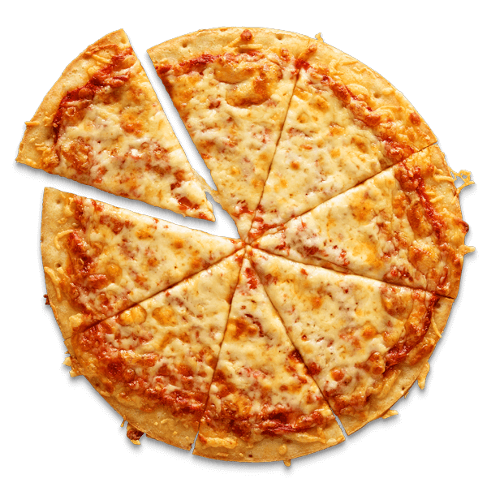
Optimize This!

Slide 13
Thanks for Joining!
Any questions?

