Slide 1

Vygorade
Paige Taylor, Brandon Black, and Jason Pisani
Notes:
Paige

Slide 2
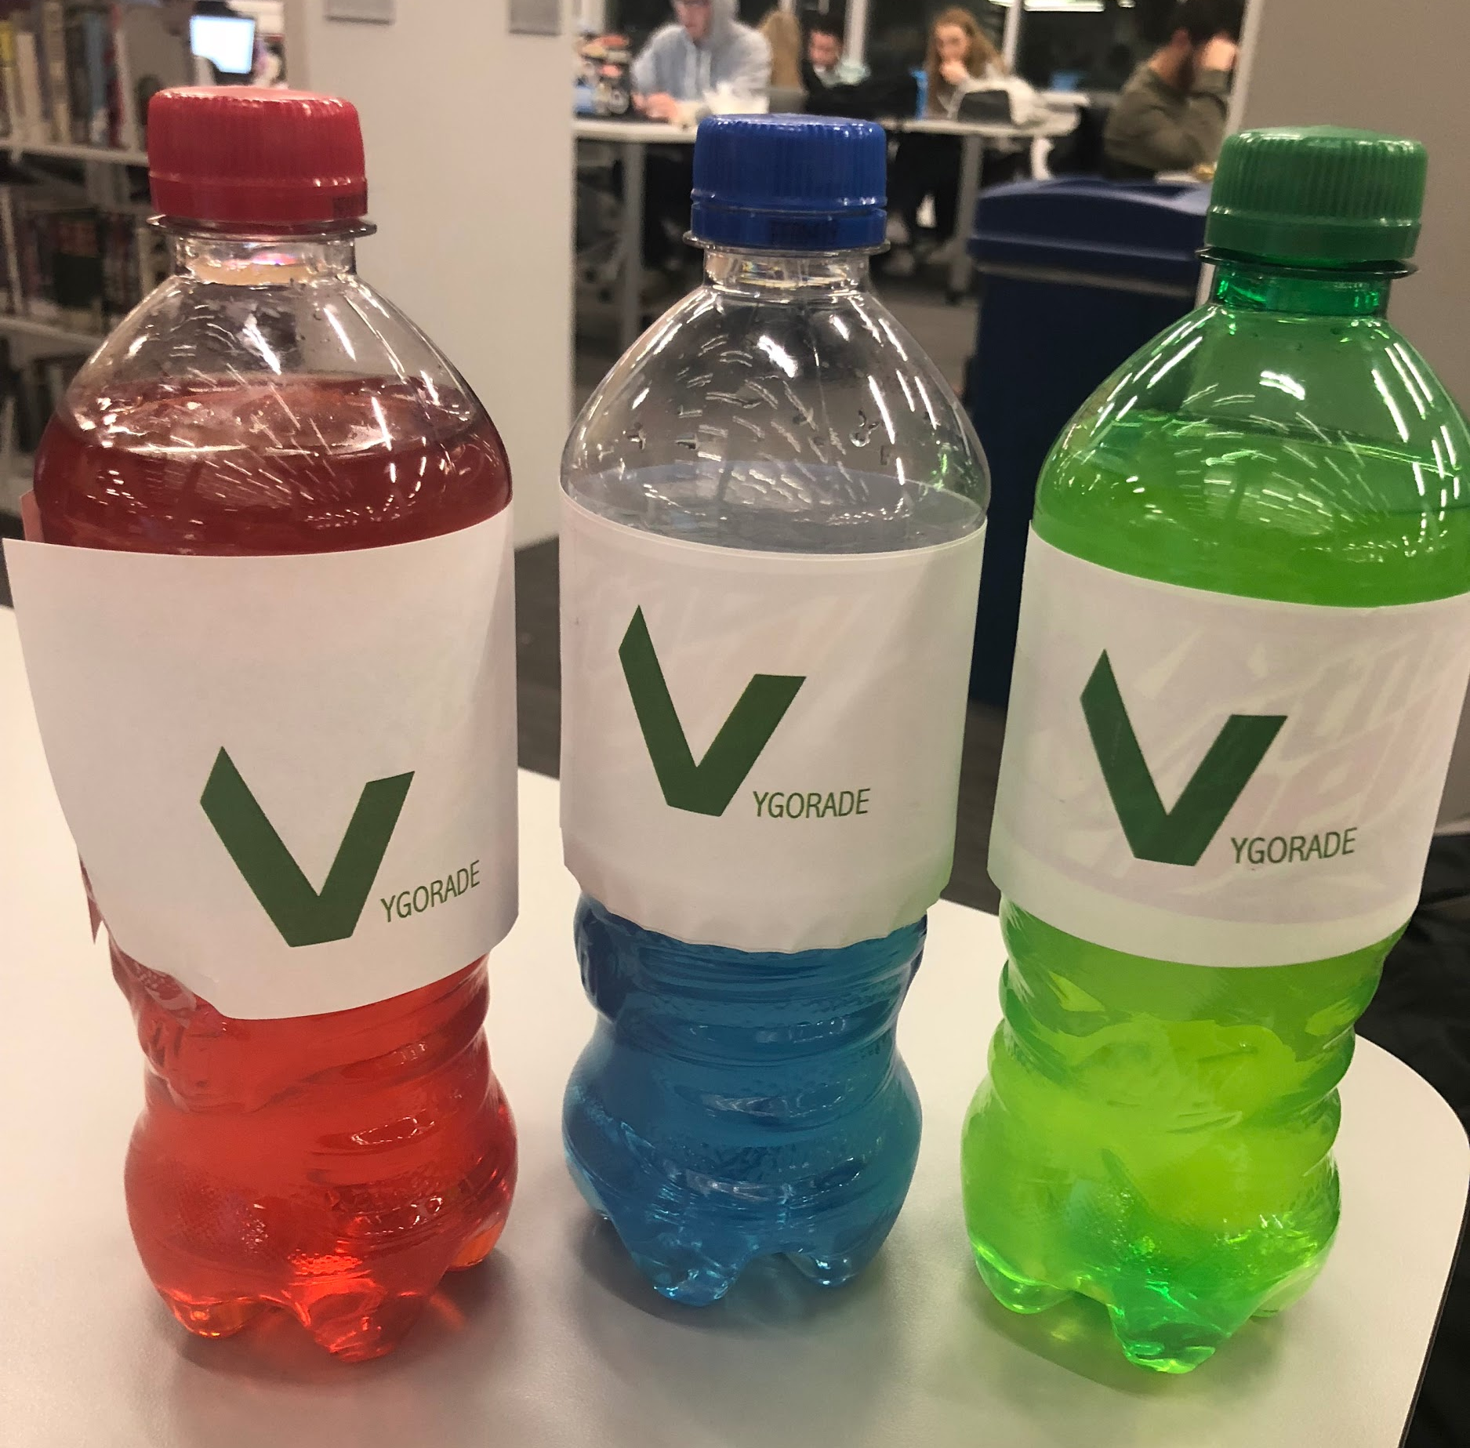
Executive Summary
Vygorade embodies an eco-friendly and a health conscious life for students and young professionals. Our drinks combine the best parts of sports and energy drinks.
Vygorade will be bottled with recycled materials and manufactured in an environmentally friendly facility.
Notes:
Jason

Slide 3
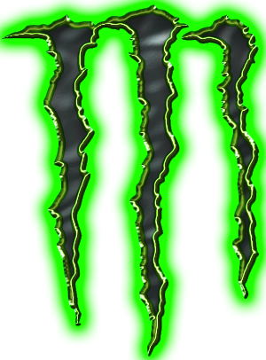
What is an Energy Drink?
“Energy drinks contain stimulants, primarily caffeine and sugar, which give a temporary boost to performance. Because caffeine concentration in the blood peeks about two to four hours after consumption, the caffeine boost is usually maximized if the beverage is drunk 1-2 hours prior to the start of an endurance activity.”
Notes:
Jason

Slide 4

What is a Sports Drink?
“Sports drinks are the most appropriate hydration fluid during strenuous activity. They contain no stimulants, only carbohydrate, and salts to replace those lost in sweat. A sports drink helps replace carbohydrates and electrolytes and is better at minimizing the possibility of dehydration than water alone.”
Notes:
Jason

Slide 5
Description of Product
Vygorade contains caffeine, carbohydrates, and electrolytes.
This will benefit our target market as the caffeine will give them energy they need and replenish the things they lose during strenuous activities.
We ‘ll sell these at convenience stores, markets, and gas stations.
Notes:
Jason

Slide 6
Why Vygorade is Different
Vygorade is a drink incorporating the positive aspects of both a sports drinks and energy drink into their formula. This is a safe alternative to other energy sources or supplements.
Notes:
Jason

Slide 7
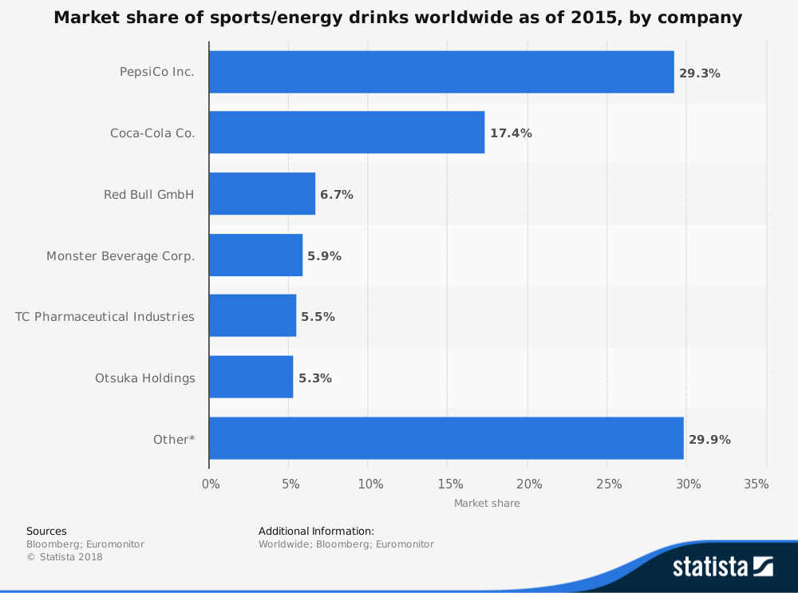
Product Marketplace
Competitors
Target Market: Students and young professionals who drink sports or energy drinks in order to replenish or increase activity during and after workouts or while in the office.
Notes:
Paige

Slide 8
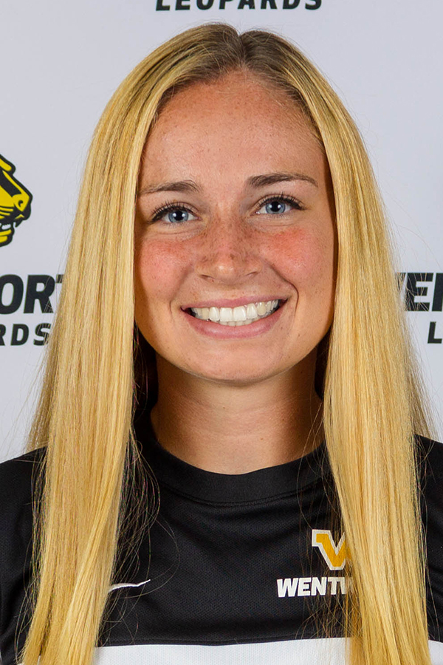
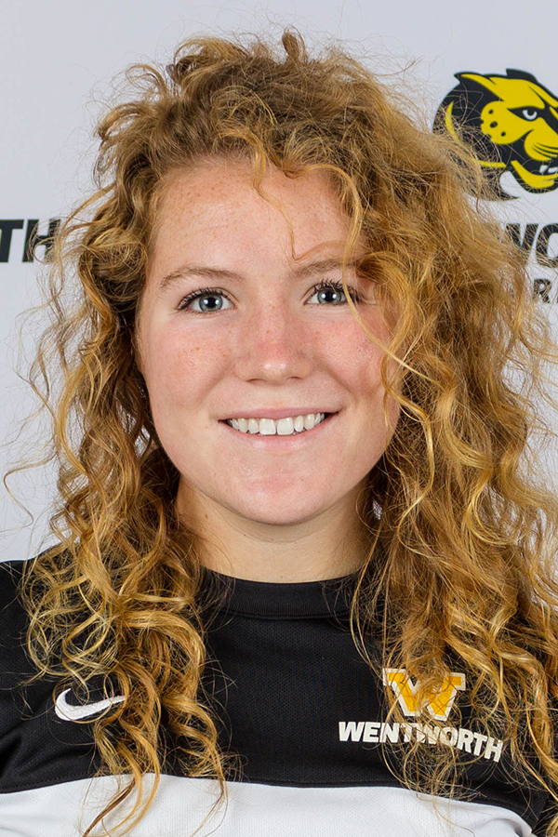
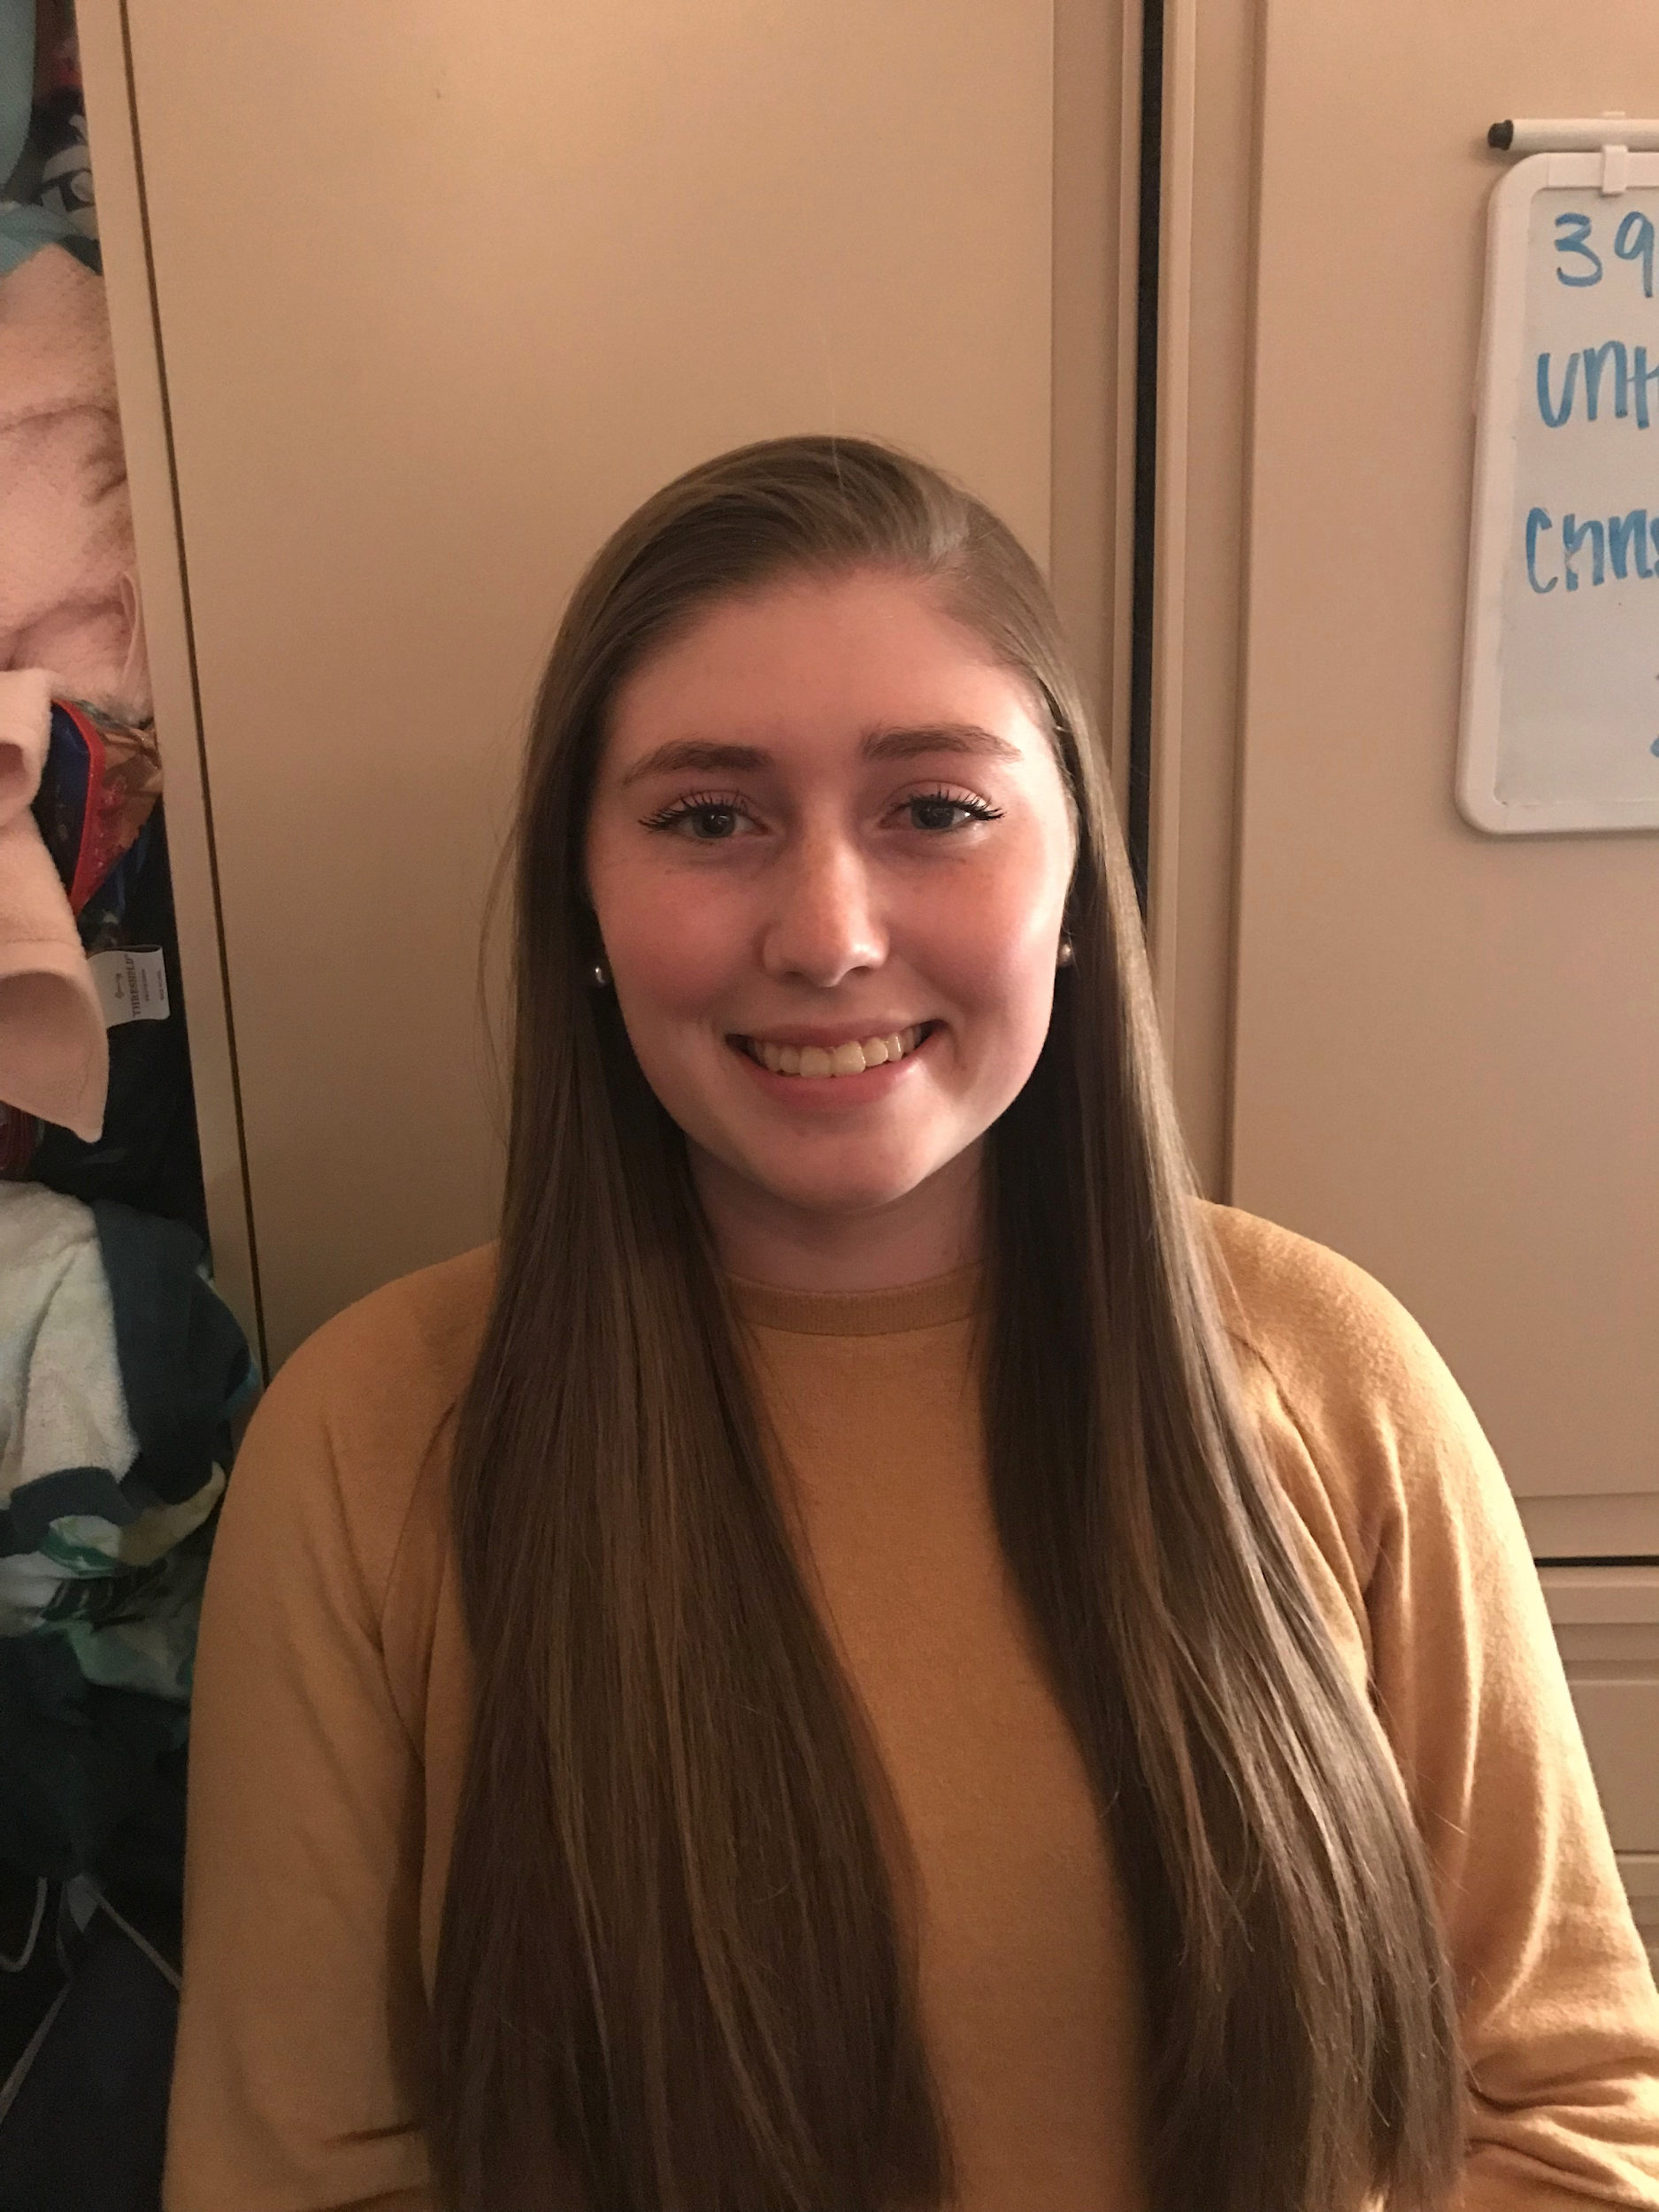
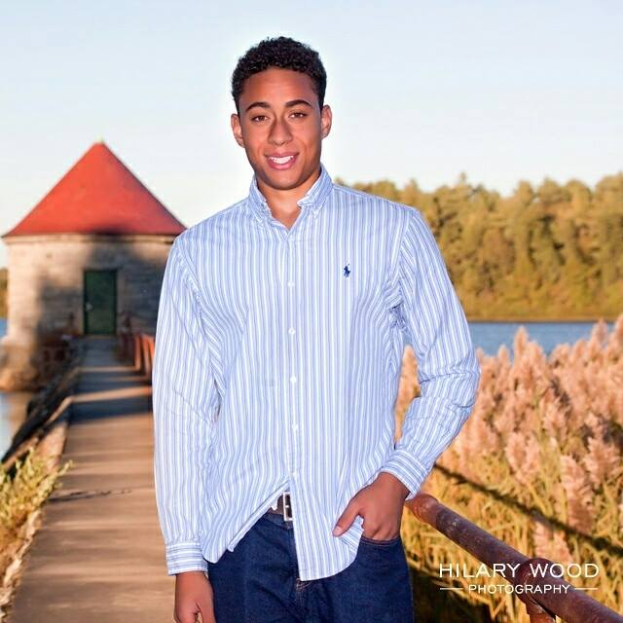
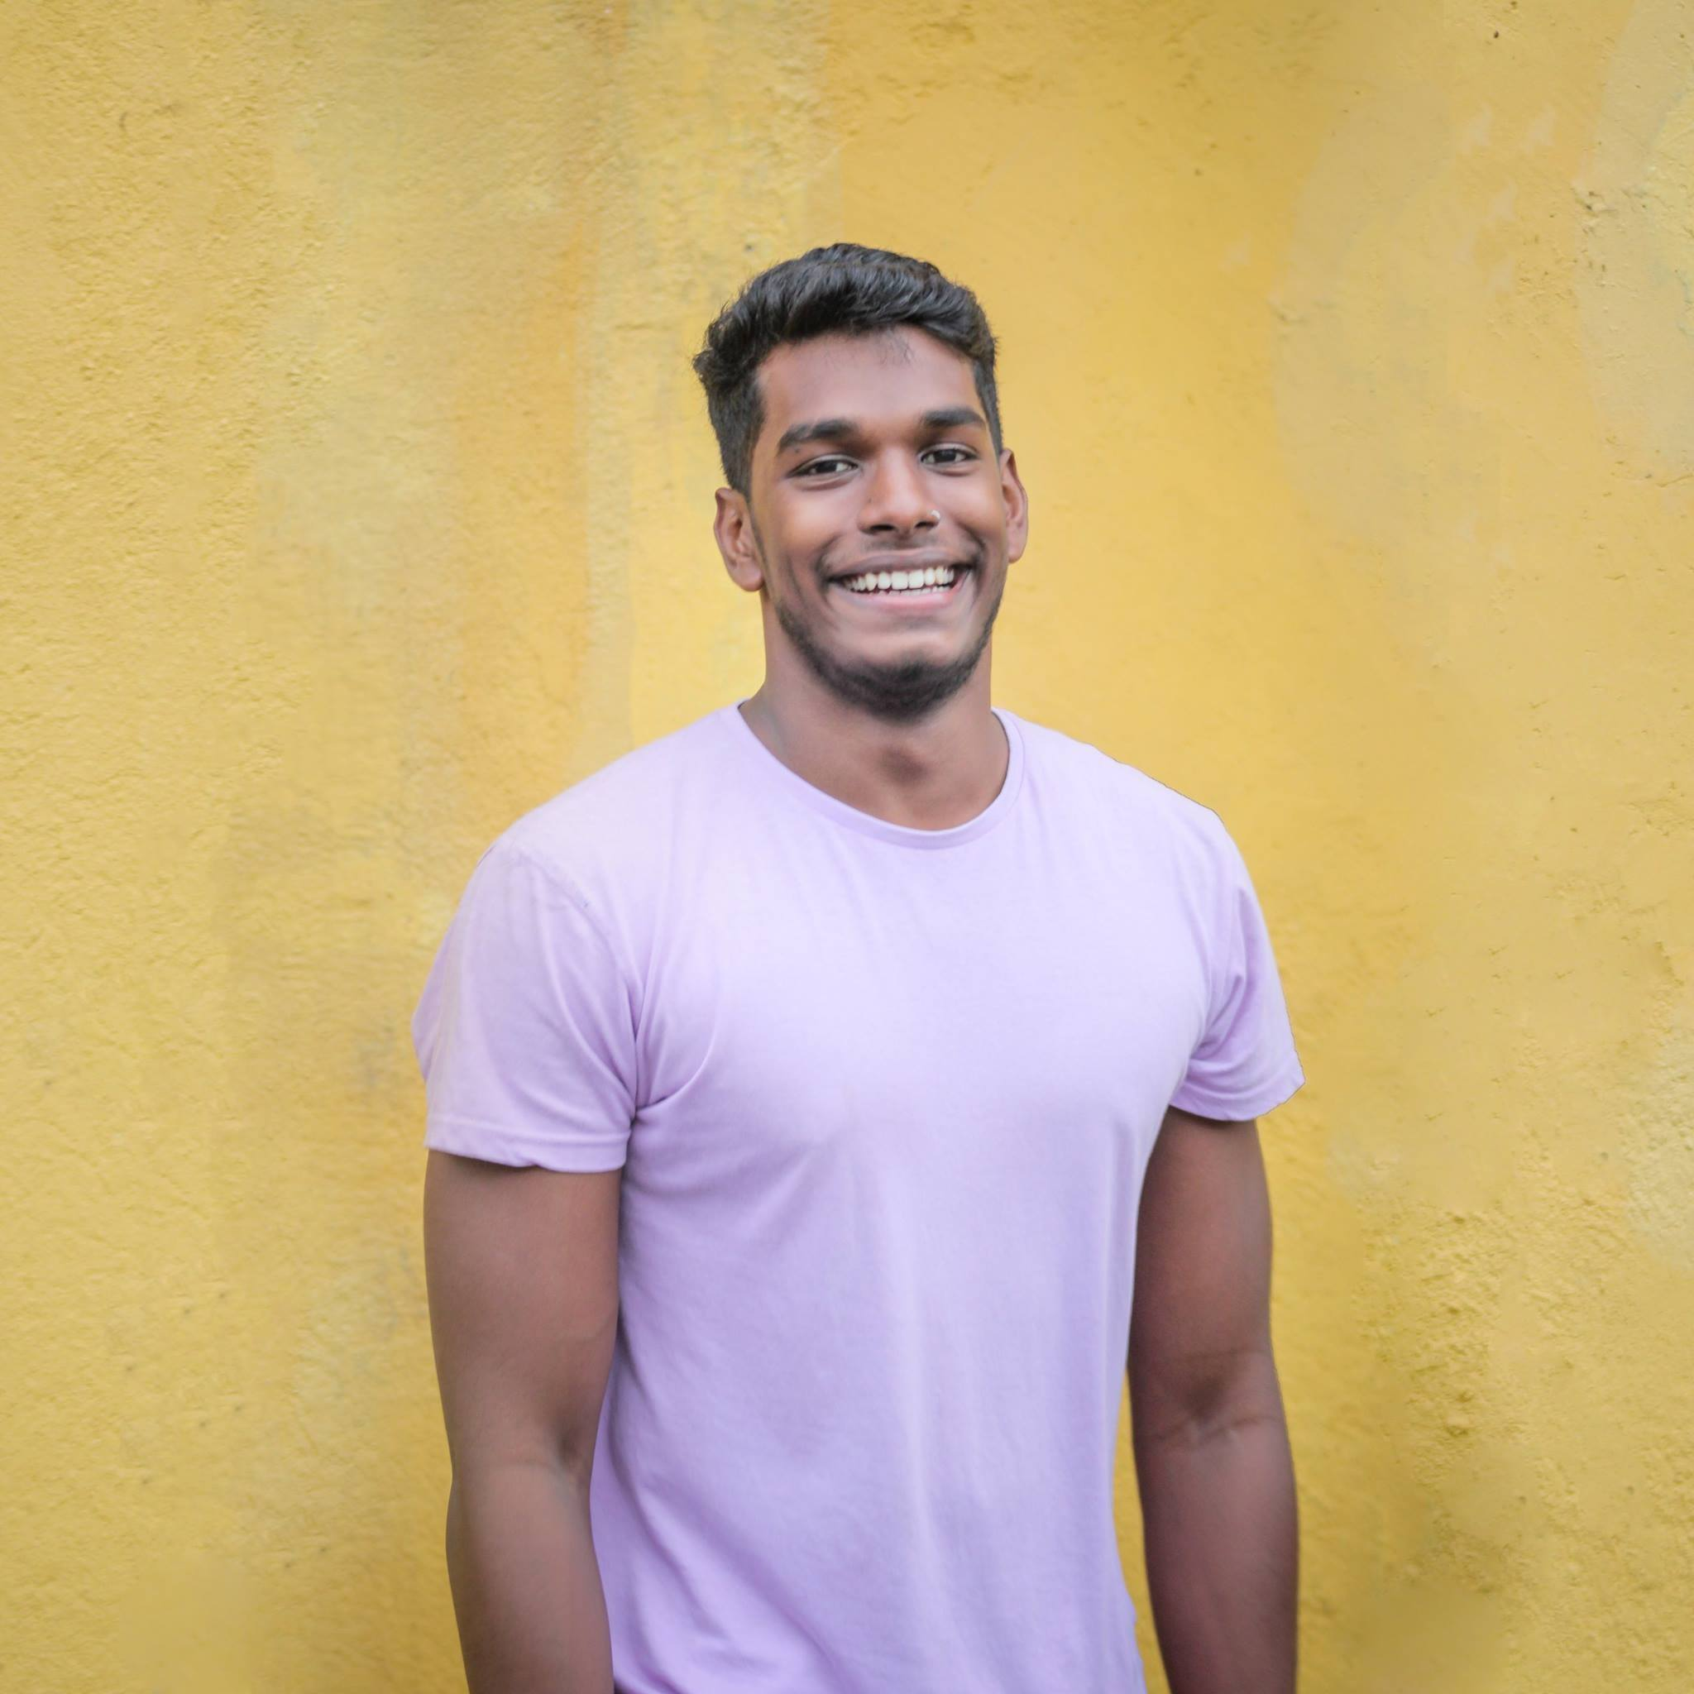
Marketing Strategy
The Vygorade Team is working on developing a commercial including Wentworth students as well as some working professionals. These actors include Julie Mckenna, Alexis Stickelman, Elijah Hernandez, Alex Kielty, and Kathesh Handy.
Notes:
Paige

Slide 9
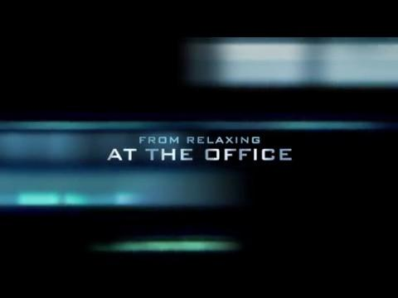
Marketing Strategy Continued
Notes:
Paige

Slide 10
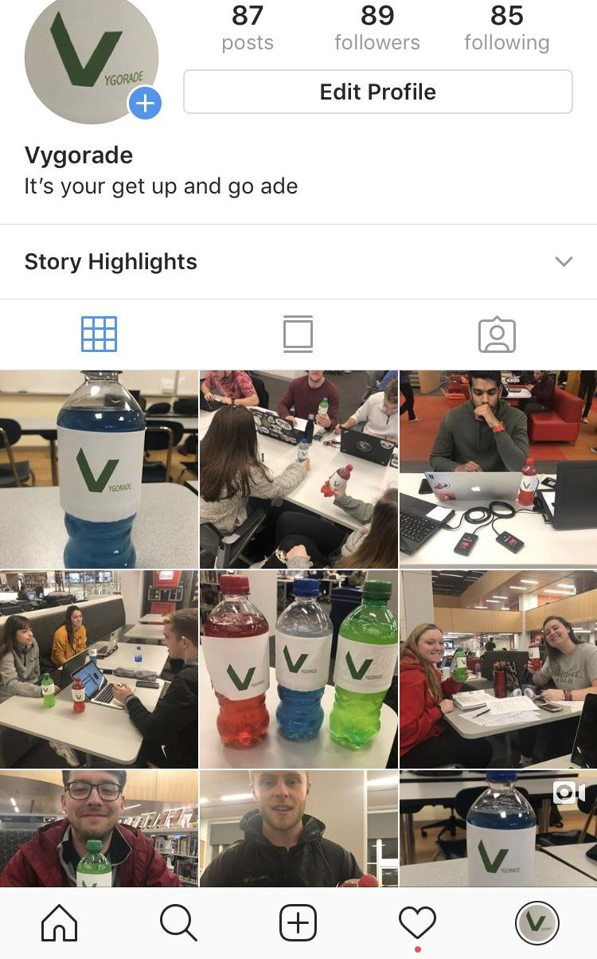
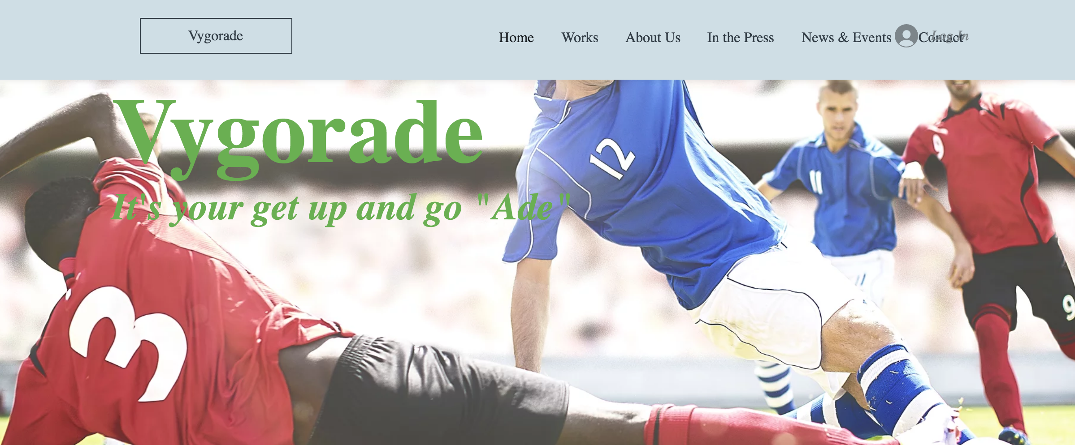
Marketing Strategy Continued
k
k
Notes:
Garrett

Slide 11
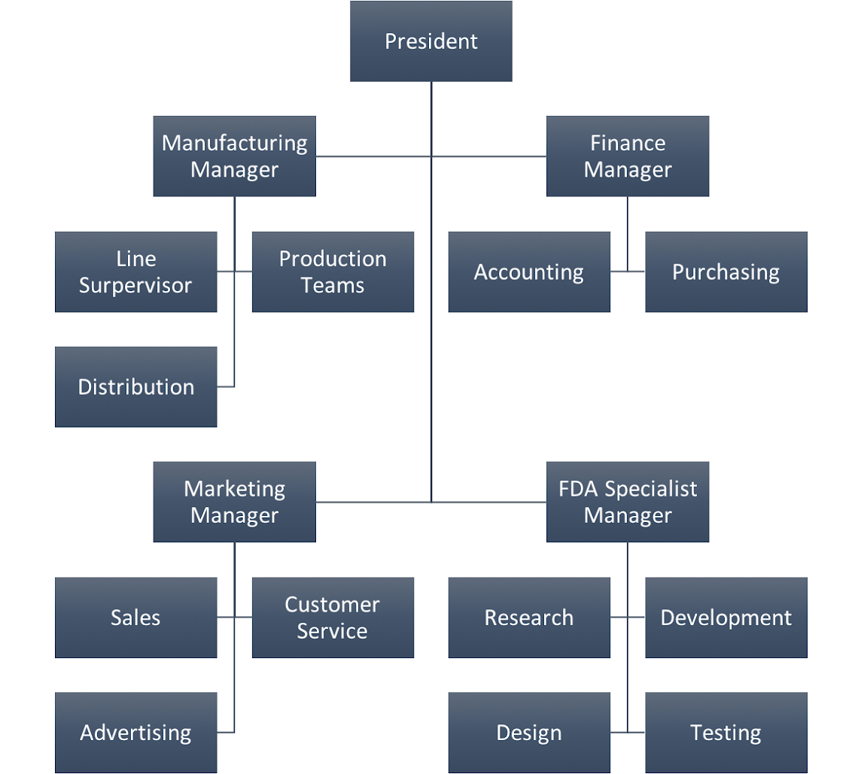
Organization and Staffing
Notes:
Paige

Slide 12
Financial Projections
Measure | Year 1 | Year 2 | Year 3 | Year 4 | Year 5 | 5 Year Total
Sales Projections | $300,000 | $500,000 | $680,000 | $800,000 | $1,200,000 | $3,480,000
Staffing Costs | $150,000 | $180,000 | $210,000 | $240,000 | $270,000 | $1,050,000
Advertising Costs | $20,000 | $16,000 | $10,000 | $8,000 | $7,500 | $61,500
Manufacturing Costs | $70,000 | $80,000 | $90,000 | $100,000 | $110,000 | $450,000
Rent Costs | $5,000 | $5,000 | $5,000 | $5,000 | $5,000 | $25,000
Projected Material, Shipping | $40,000 | $56,000 | $69,000 | $77,000 | $83,000 | $325,000
Insurance Costs | $2,000 | $5,000 | $6,800 | $8,000 | $15,000 | $36,800
Additional Web Server and IT Hosting/Maintenance | $20,000 | $24,000 | $28,000 | $32,000 | $35,000 | $139,000
Total Cost for In-Store Sales | $287,000 | $340,000 | $397,000 | $449,000 | $518,000 | $1,991,000
Cash Inflow | $13,000 | $160,000 | $283,000 | $351,000 | $682,000 | $1,489,000
Notes:
Jason

Slide 13

Ingredients and Regulations
Must register and abide by FDA rules and regulations
FDA testing and approval isn’t necessary as long as
  No new food additives are used
  Only naturally sourced or pre-approved colors are added
FDA requires companies to ensure that their packaging is safe
Notes:
Jason

Slide 14
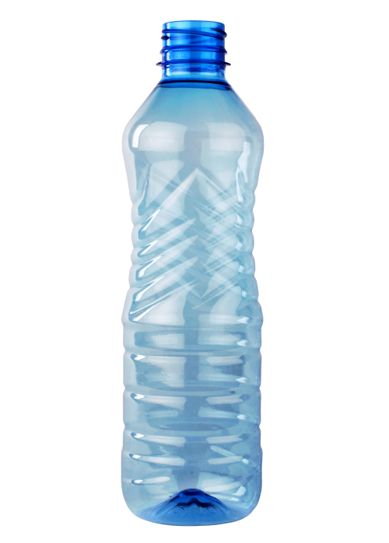

Technology Considerations
Bottle
  -Thermoforming machine to mold recycled bottles
Label
  -Label printer necessary for mass production of labels
Environmentally Friendly
  -Reusable bottles and powder mix
Notes:
Reusable bottles similar to gatorades
Brandon

Slide 15
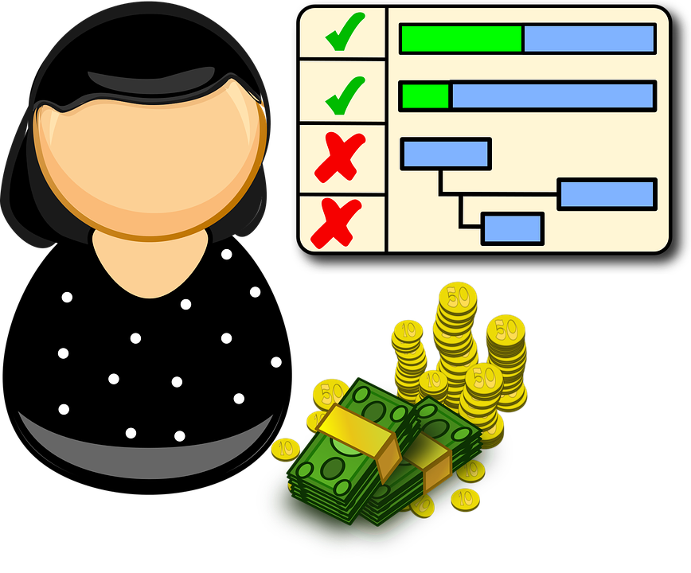
Schedule
Sep 25, 2018: Initiate Project
Oct 1, 2018: Decide on Name and Logo
Oct 8, 2018: Finalize Ingredients in Drink
Oct 29, 2018: Get FDA Approval
Nov 5, 2018: Create and Develop Website
Nov 5, 2018: Create Instagram Page for Product
Nov 12, 2018: Begin Marketing Campaign
Nov 12, 2018: Film Commercial
Nov 19, 2018: Decide on Flavors for the Product
Nov 26, 2018: Complete Taste Tests for Product
Dec 3, 2018: Decide on Final Product to Rollout
Dec 17, 2018: Rollout Final Product to Public
Notes:
Brandon

Slide 16
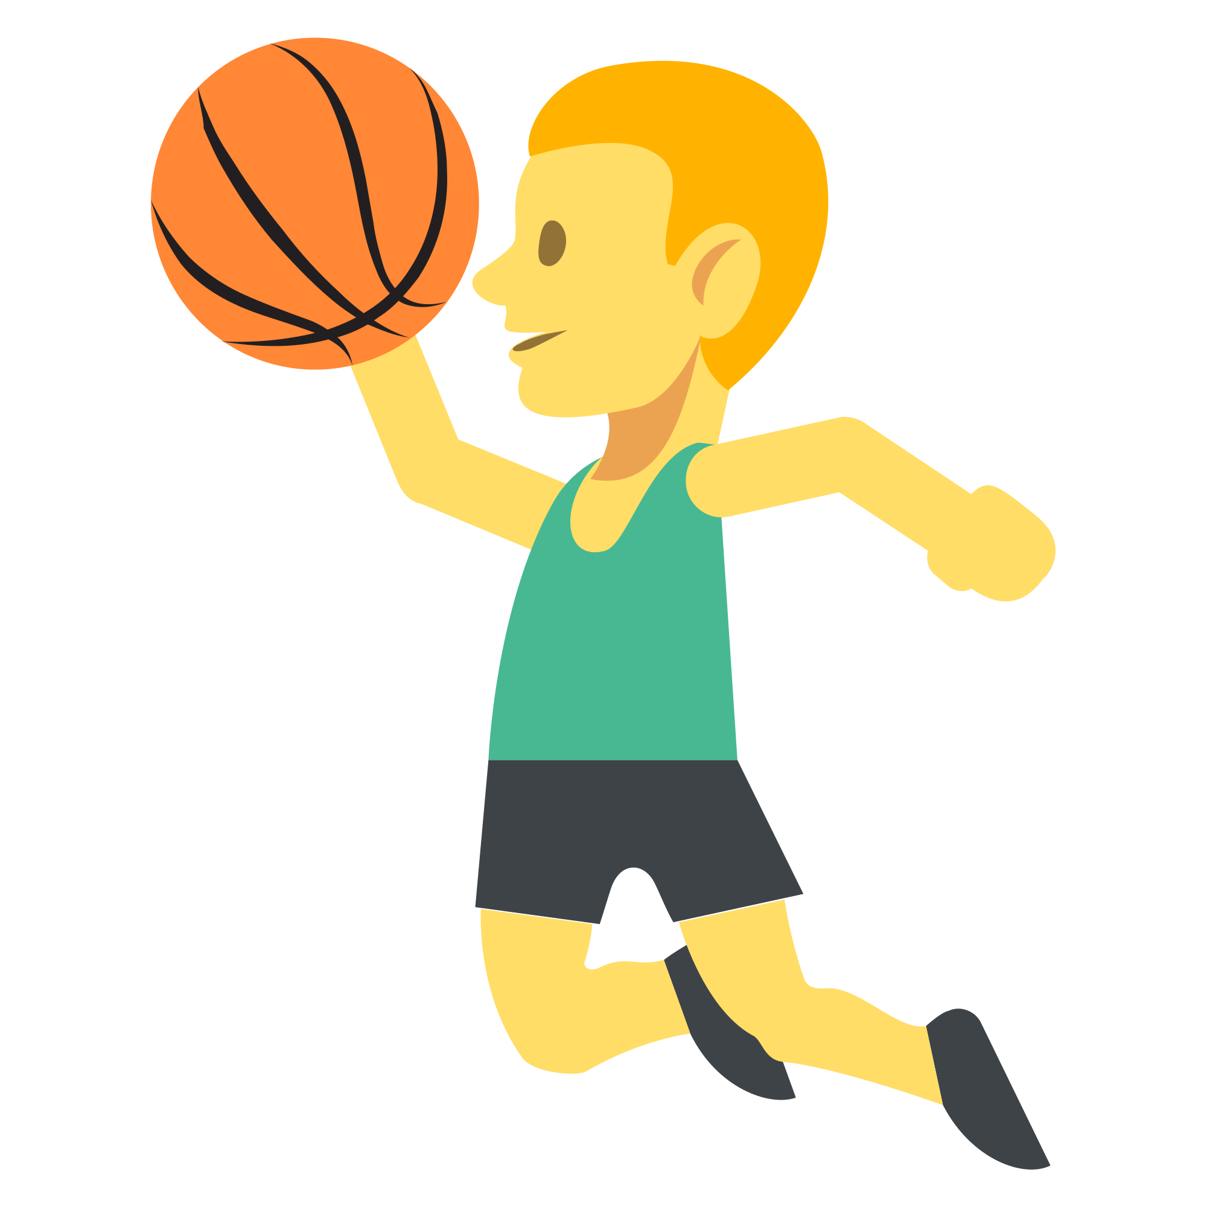

Findings and Recommendations
Marketing
Target Market
    Students and Young Professionals
      Active (sports/exercise)
Instagram
    Growing social media platform
      Best way to build hype for the brand
Notes:
Brandon

Slide 17

Findings and Recommendations
Organizational
Started by three Wentworth Business Management Students
    Focused in Marketing and Finance
Must hire outside sources to finalize drink
    FDA Specialist
    Sports Nutrition Specialist
    Dietician
Notes:
Brandon

Slide 18
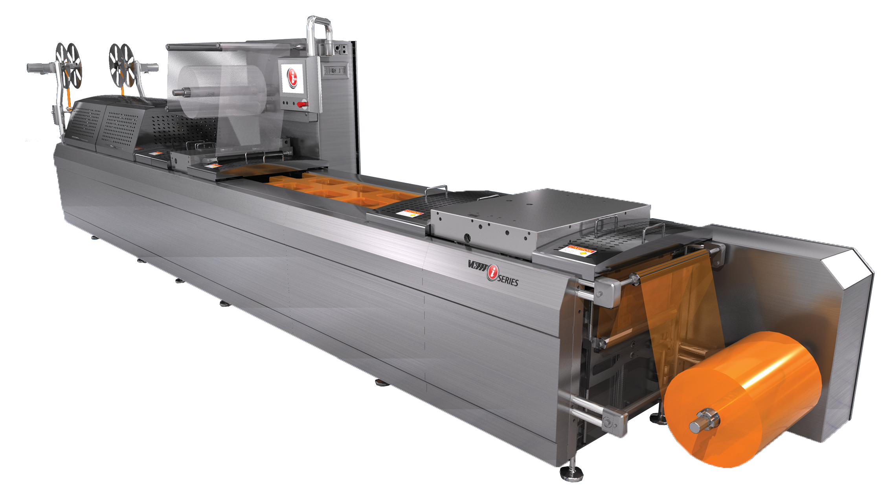
Findings and Recommendations
Technology
Utilize existing technologies to make bottles and labels
    Thermoforming Machine
    Label Printer
Rent a server for web capabilities
    Costs anywhere from $50-$500 yearly
Notes:
More expensive web servers are if we completely customize the website rather than use a premade theme
Brandon

Slide 19
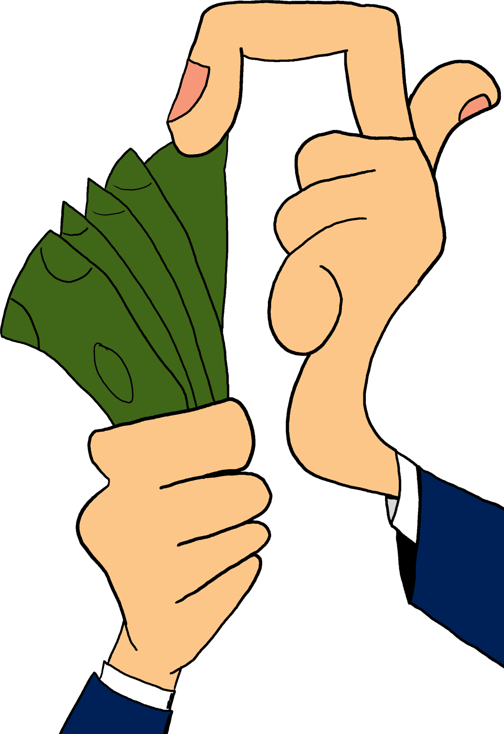
Findings and Recommendations
Financial
Lower salaries is an easy way to reduce costs
Typical product liability insurance is $0.25 of each $100 that is made by the company
  .0025 * Sales Projections
Insurance will rise over time
Notes:
Jason
I can say “Jason will conclude with our financial findings here” it will sound fine

Slide 20
THANK YOU!

